Slide 1
ACT with Children, Adolescents, and Parents
Brussels, October 3-4
Lisa W. Coyne, PhD
Program Director, Pediatric OCD Institute, Harvard Medical School/McLean
Associate Clinical Professor, Suffolk University
Director, New England ACT Institute
Vice-President, New England Chapter of ACBS

Slide 2
Learning Objectives
To contact the space in which ACT is done
To learn how conceptualize child, adolescent, and parenting cases from an ACT perspective
To learn about the current assessment of ACT relevant processes in youth
To address each of the six core components in work with children, teens, and families

Slide 3
Informed Consent
An opportunity to participate in experiential exercises
An invitation to be vulnerable, in the service of learning
….see what happens

Slide 4
Introductions & Learning Goals
Notes:
A Morning Dedication from David Whyte

Slide 5
Centering Exercise
Notes:
Brief mindfulness meditation; I invite you to step into this space
In the service of something you care about. What might that something be?
-Pause-
Intend for today to make a difference What if it required that WE step forward?
Are you willing…
To Be Open…
To sit with all of your feelings, thoughts, experiences, with compassion, and without defense
To Get Centered…
To venture into new places where you don’t have a map: to keep a beginner’s mind
To Engage…
To act boldly and creatively in the service of your clients…if that is what it takes to make a real difference in their lives?
Your mind may tell you that this is possible/not possible…gently acknowledge that thought and hold it lightly in your heart…and bring your attention back to what you most care about in this moment, in this workshop, today

Slide 6
The Heart of ACT

Slide 7
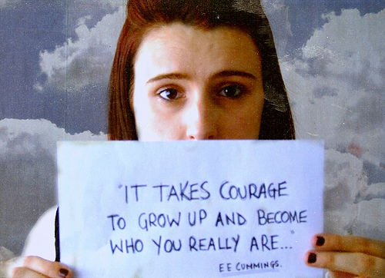

Slide 8
Children, Teens & Parents Suffer, too

Slide 9
A little data on “disorders” in youth…
At least 1 in 4 or 5 young people aged 12-24 will suffer from a mental health disorder in a given year
75% of those with mental disorders experienced onset before age 24 (US, National Comorbidity Study)
One in four children *not* diagnosed experience functional impairment in at least one domain (Espeleta et al., 2001)
Suicide
    3rd leading cause of death in 15 to 24 year-olds
    6th in ages 5 to 14
Up to 100% of mental health needs are unmet in developing countries (Patel et al, 2007)
Notes:
-Relationship with MH disorder: 12.9% disorder prevalence; of these,
* 41% had disorder without disability;
*58.2% had disorder plus one disability.
*Conduct disorders and depression had highest rates of disability.
*27% of the total sample had one or more areas of disability.
*Of these, 27.8% had a disability with diagnosis (72% did not have a diagnosis).

Slide 10
Is suffering abnormal?
Many children, teens, and families suffer
Substantial rates of comorbidity
Doesn’t count the enormous number of “subclinical” cases or non-diagnosable functional impairment
Kids’ problems aren’t necessarily restricted to or captured by our diagnostic system
  Parent-child relational problems
  Peer rejection & victimization
  Multiple contextual stressors of poverty
  Teachers who think You can’t. You’re not smart enough.
Notes:
Do you know anyone who doesn’t have a small piece of this? Open a book to the page you don’t want others to see.

Slide 11
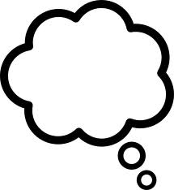
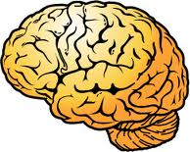
What is at the heart of this suffering?
Words make
monsters present

Slide 12
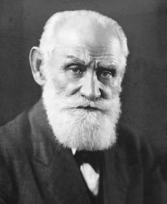
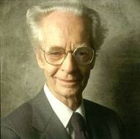


A Contextual-Behavioral Account of Suffering
Learning Histories
Direct Conditioning
  Respondent
  Operant
Indirect Conditioning
  Relational
Notes:
There are lots of ways to explain or talk about this. One way is learning, which itself can be discussed in a variety of ways. I will talk about a contextual- behavioral account of learning (because it is the way I am most familiar with) . There are different ways, even within a behavioral perspective, to talk account for suffering. There is the more traditional stimulus-response account, and that is the tradition that my work comes from, but I am also interested in the ways that context organizes thoughts, feelings, and behaviors. The first two types of conditioning, which you are probably more familiar with than the third, are the result of direct conditioning experiences. Within the traditional behavioral model, there was no good account of language and cognition until recently. The third type of conditioning refers to indirect or verbal learning. It provides a behavioral account for language and cognition. I will talk about of these briefly in order to help understand how psychopathology might be established and/or maintained.

Slide 13
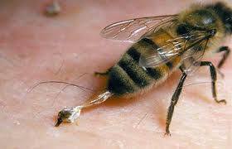
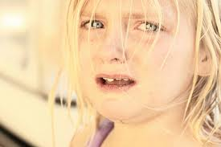
Respondent Conditioning: First Things First
US
UR
Reflexive: No learning necessary
Survival value

Slide 14
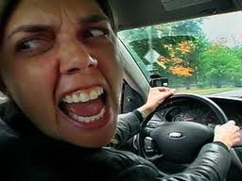
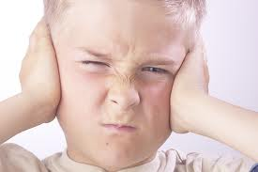
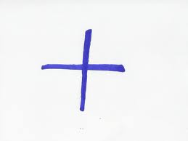
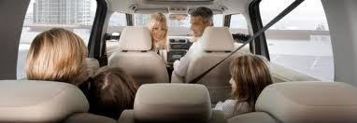
So What’s Respondent Conditioning?
UCS
UCR
NS
After repeated pairings of UCS + NS…
Notes:
Examples of Unconditioned stimuli
Object in throat
Puff of air in eye
Intense heat
Loud noise
Blow to knee
Food in mouth

Slide 15
What was once neutral
comes to have particular psychological properties
CS
CR
Notes:
Examples of Unconditioned stimuli
Object in throat
Puff of air in eye
Intense heat
Loud noise
Blow to knee
Food in mouth

Slide 16
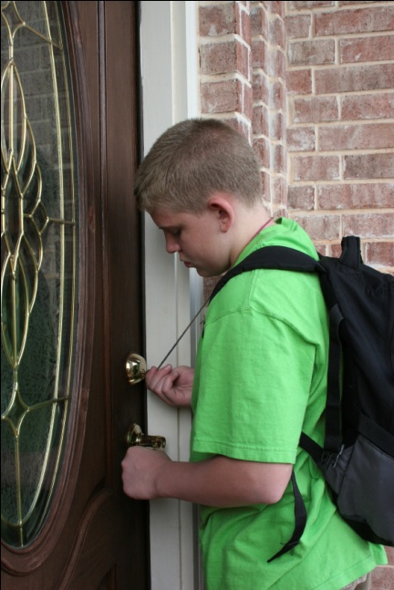
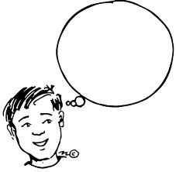

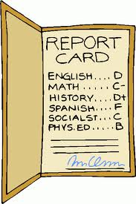
The A-B-Cs of Operant Conditioning
Chilling out
Short term ?
Long term ?
A
Antecedent
B
Behavior
C
Consequence

Slide 17
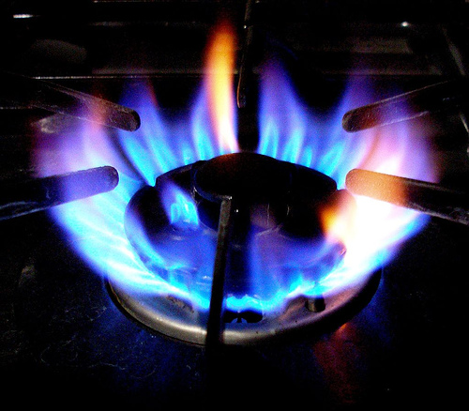
Indirect (Relational) Conditioning
Notes:
CUT THIS SLIDE
So far the conditioning I have talked about refers to things that have been experienced directly. They are learning processes that affect all animals, including humans, however these processes do not fully explain human learning. Humans also learn through indirect or verbal conditioning. Generally speaking, this means we respond to events in terms of other events, in other words, in terms of the meanings we attribute to those events. I will explain. There is not yet evidence that this happens in nonhumans or in humans without language abilities; however, in most people it develops early in life. I have some data but first let me make a caveat…
Verbal in this case refers not just to speech but to any and all communicative behavior and really any behavior that is the result of relational learning, so sign-language is verbal, for example

Slide 18

How Relational Framing Works
Elephant
Bigger than
Bigger Than
Smaller
Than
Smaller
Than
Bigger Than
Blue Whale
Hippopotamus
Smaller Than
Notes:
Mutual Entailment
Combinatorial Entailment

Slide 19
Important Features
Things can be related in arbitrary ways
  E.g., banana_______ catapult
Contextual cues govern how they are related
  Singing in the shower vs. singing in public
Relations tell us how to respond
  As though they are rules (eg, bigger = better)
This allows us to engage in novel behavior, without having experienced situations directly
All members of a frame come to have similar psychological functions

Slide 20

How Does Transformation of Stimulus Function
Work?
Let’s see.

Slide 21
Some Relational Frames
Coordination: Like, same as
Comparison: Bigger/smaller, better/worse, more/less
Distinction: Different than
Spatial: Here/there, above/below
Temporal: Then/now
Perspective: I/you
Hierarchical: Me/my thoughts

Slide 22
Types of Rule-Governed Behavior
Pliance: reinforcement delivered based on frame of coordination between rule and behavior
  “Listening” only to my thoughts
Tracking: reinforcement delivered based on history of coordination between rule and environmental consequences independent of the rule
  “Listening” to feedback the world gives me
Augmenting: due to relational networks that alter the degree to which events function as consequences
  What if I asked you…

Slide 23
But when do kids’ minds start to work this way?
Sticks and stones may break my bones but words will never hurt me.
- Children’s saying

Slide 24
Relational Framing
Mutual entailment emerges by 17 months
“Ball”
87.5%
(4 pairs)
Under 12 months:
http://www.youtube.com/watch?v=N9oxmRT2YWw
Lipkens, Hayes, & Hayes (1993)
Notes:
This is data from Lipkens et al. in Journal of Experimental Child Psychology in 1993- They used a single male participant and studied him over an 8 month time period-taught him to match pictures of objects to their spoken names and then tested on the opposite direction both immediately and a 2-week follow-up- got nearly 88% correct
Child derived the opposite in the absence of direct training. “Derived stimulus relations” Mutual entailment : if A is related to B in a given context via training, then B is related to A in that context via derivation. Specific relations involved need not be literally identical – for example, if A is better than B, then B is no worse than A – but the second relation is entailed by the first.

Slide 25
Relational Framing
Combinatorial entailment by 23 months
Around 2 years:
http://www.youtube.com/watch?v=d_tB89jP7XI&feature=related
“Ball”
90%
(4 pairs)
Sound
of ball
bouncing
Lipkens, Hayes, & Hayes (1993)
Notes:
Same article, same participant: By 23 months could do more complex framing, when added that certain sounds went with certain pictures, was able to put names with sounds and vice-versa 90% of the time
Combinatorial Entailment: If A is directly related in a particular way to B, and B is also directly related to C, then some kind of relation must be entailed from A to C and from C to A. The derivation of transitive and equivalence relations in the stimulus equivalence literature are examples of combinatorial entailment.

Slide 26
Relational Framing
Ability to form multiple relations forms by 27 months of age
  Exponential increase in frames
Around age 3:
http://www.youtube.com/watch?v=E8aprCNnecU&feature=related
Lipkens, Hayes, & Hayes (1993)
Notes:
By 27 months old he could get them all correct, even when new stimuli were introduced-
Want you to notice when this framing process happens- developmental psychologists often refer to the rapid language acquisition between 18 and 26 months of age as the language explosion and as toddlers get language, they do this framing- this has important implications. We believe that the basic processes of framing are what underlie and account for language and cognition. There is still a lot of work that needs to be done in this area.
Correlates with cognitive/verbal ability
Emotion knowledge also correlates with verbal ability

Slide 27
Relational Framing
Emerges in toddlerhood
Gets more complex
Multiple relational forms
Correlates with cognitive/verbal ability
Emotion knowledge also correlates with verbal ability
Typical
MR: Language
Chance
MR: No Language
Around age 3:
http://www.youtube.com/watch?v=E8aprCNnecU&feature=related
Devany, Hayes, & Nelson (1986)
Notes:
However, there is some evidence that this ability is related to language ability. This refers back to the statement that I made a moment ago about it not occurring (that we know of) in people who are nonverbal. In a 1986 study published in Journal of the Experimental Analysis of Behavior Devany et al. used 12 children ages 14 to 36 months as participants, there were 4 normally developing with average IQ, 4 language-capable children with mental retardation and 4 children with language deficiency and mental retardation to study this process- trained that 2 animal-like pictures went together, then trained that one of those went with a third animal-like picture, and then tested to see if could get that first and third pictures went together-did with two sets and then mixed those two sets, training was “touch the one that goes with this one” followed by one or more of the following: verbal praise, bubble blowing and food reward, and if failed physical prompting was used- 10 trials in each block of testing (so 40 total)- can see that normally developing and language able children with MR did about the same and those without language performed at worse than chance levels

Slide 28
RFT and Self (McHugh, Barnes-Holmes & Barnes-Holmes, 2004)
Theory of mind
  Perspective-taking as relational responding
  Relational frames I-You, Here-There, Now-Then
  Developmental – early childhood group had the most errors; adults had the least
  Perspective-taking can be trained
    Later studies have showed its utility in teaching children on the autistic spectrum ToM

Slide 29
Josie, at 10 years old
Josie
Friendly, creative , confident, smart
Daughter of Lisa and John, sister of Rory, owner of Lizzy and Marco
Lover of my family, Cape Cod, and hiking
Who feels excited in the summer, tired during the schoolyear, happy with my friends
Who needs sleep because she’s tired, a book to entertain her, her friends to hang out with
Who gives loves to family members and friends to show I care about them, respect to everyone to be nice, fairness to my classmates and teachers, to include everyone
Who fears getting horrible grades because it disappoints me, getting in trouble because I hate the feeling I get when I do, and spiders because I don’t want to get bit by a poisonous one
Who would like to go see a real live whale, a real live gorilla, and the inside of a cave
Resident of MA
Coyne
Notes:
Kids are in the unique position of having fine, critical minds, and yet being limited in the ability to understand and appreciate how they work given their less sophisticated abstract thinking and verbal skills. This varies across childhood, of course. But the mind’s relational abililty begins very young.

Slide 30

According to an article
in the January/February issue
of Scientific American Mind
by Kipling D. Williams,
a professor of psychological
sciences, the brain registers
ostracism as physical pain.
http://www.youtube.com/watch?v=37_ncv79fLA

Slide 31
And what about parents?
Although families are the crucible of the future and the primary molders of children’s values, parenting is one of the most undervalued and least prepared for roles…
-Marian Wright Edelman

Slide 32

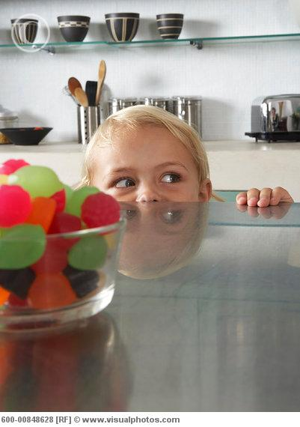

Impaired Parenting: Externalizing Behaviors
Classical and operant conditioning
  Child becomes aversive
  Escalation or acquiescence

Slide 33

My Child’s Bad Behavior = ?
She’s bad
I’m hopeless
I’m useless
I tried that
Embarrassed
I hate her
Doesn’t work
She’s hopeless
She’s hopeless
No future
I can’t fix it
She’ll flunk
She hates me
Failure
All my fault
I’m bad

Slide 34
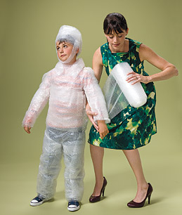
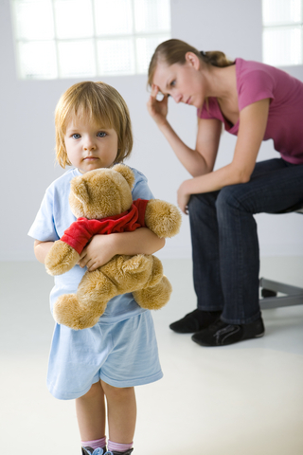
Parent Emotion Regulation: Internalizing Behaviors
Anxious parents
Depressed parents
Notes:
Anxious parents are intrusive and controlling
Can’t tolerate how they feel when their children experience distress
“Save” kids from distressing situations, thus preventing practice and mastery of those situations
Model avoidant coping for children
Depressed parents are harsh, inconsistent, less warm, and more negative
Can’t tolerate children’s challenging behavior or negative emotions, and so retreat
Young children are left without models of emotion acceptance and thus are left more vulnerable to depression themselves
Demoralizing
Often goals are at odds with child
Want therapist to “fix” child
Locate problem with child
Working to end aversives rather than for something
Very important to assess family context and related disruption in functional analysis
Find out what was lost
Engage parent as partner in treatment
Help them make a space for their child’s goals

Slide 35
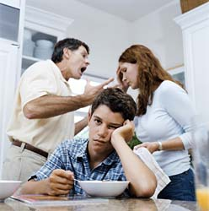
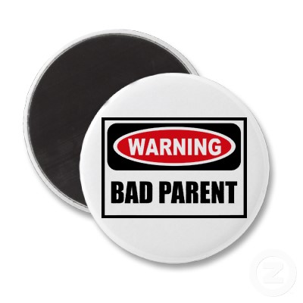
Here’s the logic…
My kid = a problem
My job as a parent =
solving problems
I can’t solve this therefore …

Slide 36
So where do you start?
Time for a break
Notes:
Break?

Slide 37
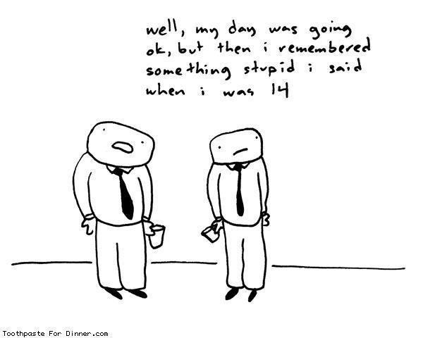

Slide 38
ACT as a Transdiagnostic Approach
ACT is a “transdiagnostic approach”
  Not symptom reduction
  Focused on building broad and flexible behavioral repertoires in the presence of pain
  Emphasis on what behaviors “work” and “don’t work”
  Goal is to help client contact these contingencies
Experiential avoidance & cognitive fusion are at the heart of psychopathology across categories
  Psychopathology is viewed as persistent engagement in narrow, rigid, avoidance-based behaviors

Slide 39
Acceptance and Mindfulness Processes
Notes:
Mostly about antecedent control- examine and attempt to manipulate what happens before avoidant and other problem behaviors in order to predict and influence it- will come back to this
ACT is comprised of six components that can be divided into two broad groups: acceptance and mindfulness processes (Acceptance, Defusion), and commitment and behavior change processes (Values, and Committed Action), with components Present Moment Awareness and Self as Context overlapping in each group.
Present moment awareness is defined as ongoing, non-evaluative awareness of psychological and environmental events as they occur on a moment-to-moment basis (this is also called mindfulness). The goal of present moment awareness is to being individuals in direct, continuous contact with their worlds.
The second component is acceptance. Acceptance is an alternative to experiential avoidance, and comprises awareness and compassionate acceptance of unpleasant material without any attempts to alter or avoid it. In the case of chronic physical pain, an ACT therapist might draw a client’s attention to it, or ask her to deliberately notice its quality, rather than distracting herself from it.
The next component of ACT is defusion, which targets cognitive fusion, and can be conceptualized as deliteralization of thoughts. In other words, it refers to the process through which an individual comes to understand that his/her thoughts are merely verbal events rather than actual events. For example, rather than a thought being perceived as a literal truth and serving as antecedents to avoidance, an individual might say, “I am having the thought that ….”
Self as context is the fourth component of ACT and refers to the awareness that the self is experienced as a constant, unchanging perspective from which one can observe thoughts, emotions, and external experiences as they come and go. Newer work on SaC describe it as perspective-taking.

Slide 40
Commitment and Behavior Change Processes
Notes:
Mostly about consequential control- after behavior- will come back to this but first have to talk about initial steps (the first few sessions)
The fifth component, values, refers to the individual’s domains of importance. They are not goals that can be attained, but are rather guiding principles that are thought to motivate sustained and complex chains of behavior (Wilson & Murrell, 2004). Because behaviors are enacted in the service of values, these behaviors themselves may come to have some of the rewarding psychological properties of the valued domain.
Lastly, ACT is also very explicit in its goal of fostering committed action in the service of one’s valued goals. When individuals engage in committed action in the service of their values, they are typically brought into contact with previously avoided psychological experiences. To make a “commitment” to continued engagement in these behaviors implies willingness to have those experiences, and to persist in one’s behaviors, even in the face of psychological discomfort.
This is a cornerstone of the ACT model of psychological flexibility – to continue to pursue valued ends, in the face of discomfort or stress.

Slide 41
ACT Question
are you willing to have that stuff, fully and without defense
at this time, in this situation?
of your chosen values
if the answer is “yes” that’s
Psychological Flexibility
AND do what takes you in the direction
as it is, and not as what it says it is,
Given a distinction between you and the stuff you are struggling with and trying to change
Notes:
We’ll to talk in some detail about all of the components, first I thought that we could go through the central ACT question, which is…
First step is…

Slide 42
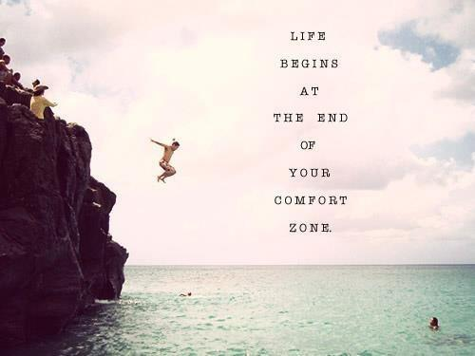
ACT means…
Accept
Connect
Take Action

Slide 43
The Goal of ACT
Pre-therapy Aim of most Aim of ACT
psychotherapies
Notes:
The blue square represents the person, the red circle their problems at the start of therapy.
Most psychotherapy aims to reduce the person's problems. This would be great if it worked long term!
ACT aims to “expand” the person – rather than living a narrow life characterised by avoiding pain and suffering, the person is enabled to live a life characterised by whatever matters to them

Slide 44
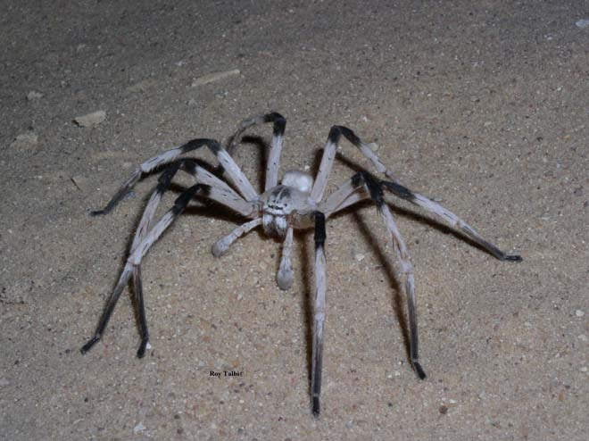

Notes:
Not noticing full experience
Limited experience of the self
Defending against experience
Even when it’s getting in the way of what we want and the person we want to be

Slide 45


Notes:
I think that’s exactly what ACT is about - Creating a context where our clients can move towards the lives that they would want, that they’d care for, that they wouldn’t dare strive for even when the scariest things in this world and beyond are present.
And so what do we do?
Two things-
We drop their scariest stuff in the room, which is necessarily the stuff they value the most (sometimes by plopping it down, sometimes just opening the door a crack where it can slither in)
Take steps with the client toward it
That’s all lovely, but what does RFT add?
I think RFT provides an analysis of this whole aspect of context, of learning history, that has a huge effect on human behavior. ACT is “talk therapy” - much of the context we’re manipulating is verbal.

Slide 46
Psychological Flexibility
Contacting the present moment fully and without defense, as a conscious human being, and based on what the situation affords; and changing or persisting in behavior in the service of chosen values.
Notes:
So what is inflexibility?
Not noticing full experience
Limited experience of the self
Defending against the moment
Even when it’s getting in the way of what we want and the person we want to be

Slide 47
Psychological flexibility in the service of a valued life
The Heart of ACT

Slide 48


Avoidance and well-being

Slide 49
Be present
Open up
Do what matters
Learning Psych
Flexibility
Present Moment
Harris (2009).
Act made simple.
Self as Context
Acceptance
Values
Defusion
Committed action
Notes:
To Be Open…
To sit with all of your feelings, thoughts, experiences, with compassion, and without defense
To Get Centered…
To venture into new places where you don’t have a map: to keep a beginner’s mind
To Engage…
To act boldly and creatively in the service of your values…if that is what it takes to live a life important to you?
Lack of control
Young people may not seek treatment willingly
Parents may want different things
Concrete goals vs. valuing behavior
Lack of generalization
Young people think more literally than functionally
Show. Don’t tell.
Do. Don’t explain.

Slide 50
ACT with Kids
Follow Your Heart
You Are Here
Be Curious
Present Moment
Self As Context
Acceptance Defusion
Values
Committed Action

Slide 51
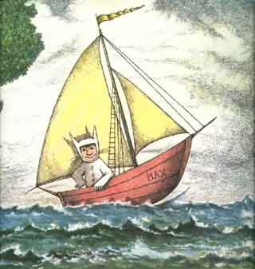
Children and the Triflex:
Emotion Adventurers!

Slide 52
Setting the Context
The Stance
  You are whole, complete, & perfect
  How you behave makes sense
The Contract
  I will stand for you
The Process
  This work won’t be easy
From an RFT perspective
  Context has been: your behavior is wrong/bad
  Your emotions are out of control
  You should be fixed or else
Notes:
Key ingredients
Being present – we ask this of our clients, we must also be so
Emotion is ok – breaks down expert – client relationship. We need to control, manage emotion – not so.
Client is not broken.
Therapeutic contract: Work will be hard, and sometimes painful. Therapist will “stand for” client. Client should be informed. Offer alternatives – cbt, get rid of symptoms, offer choice.
Client is expert on their own experience
???Exercise here on creating a space in which the client can show up – making an invitation? Thinking about adapting one from Mindfulness for Two – to help them get in the space where children live

Slide 53

Establishing the Therapeutic Stance & Contract: Role Play
Ricky is 9. His parents
brought him in because
at school he gets into
fights, has poor grades,
and few friends.
At home, he keeps to
himself. His parents are
angry, and worried,
and want him to be fixed.
He doesn’t want to be here, talking with you.
Notes:
Role Play: Why are you here? Establishing the therapeutic contract may be a process that evolves over time. Child may not know what they want to work on, so for now, that’s the work.
What do people say? Parents? Teachers? Other kids? What about you?
State your job as therapist – may not always know the right answers…
Child first, and then child with parent.

Slide 54
Mindfulness & Acceptance Processes
Notes:
Lunch?

Slide 55
ACT with Kids: You Are Here
Follow Your Heart
You Are Here
Be Curious
Present Moment
Self As Context
Acceptance Defusion
Values
Committed Action

Slide 56
Present Moment Awareness
Notes:
PLAH DOH EXERCISE

Slide 57
Present Moment
Employing flexible and focused attention to ongoing events.
  Alternative: detached focus on conceptualized past, present, or future

Slide 58
Mindfulness
“Learning to Stay”

Slide 59
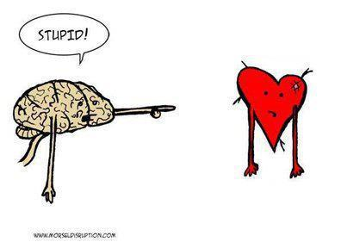
Meeting your mind

Slide 60
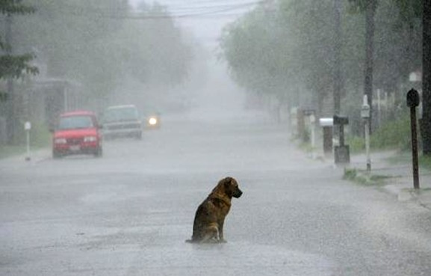

Slide 61
Finish These Sentences…
Good parents are…
Bad parents are…
I am a…
Notes:
Lisa
Notice how many things come to mind for each, how quickly. These are cultural messages, and are based on our learning histories (how we were raised, watching other families/parents, media images, etc.)
Notice any thoughts that come up for you about your own parenting as you consider these. What showed up?
Our minds are constantly giving us “rules” about what we should be/should not be, based on cultural rules. We are constantly measuring ourselves up against these standards.

Slide 62
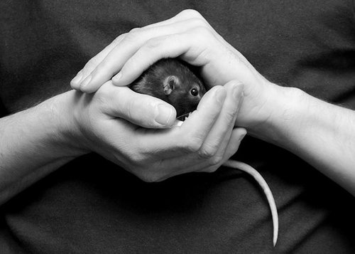
Helping Kids Meet Their Minds
Notes:
Chocolate cake…
Little game Rory plays with me.
Close your eyes – going to put something in your hand. It’s little, it’s wiggly,

Slide 63
Teaching Mindfulness to Younger Children
Teach in steps (use a shaping process)
  Your surroundings (externally – sound, light, texture, breeze, smell)
  How your body feels (internally – muscle tension/relaxation, noticing different parts)
  What your mind is saying/what pictures you are seeing
  A pleasant memory (note that memories show up and are part of your “present” experience)
  A sad or uncomfortable memory
  Noticing when you get hooked by “sticky” thoughts
  Noticing changes in your body when you get hooked
  Gently bringing yourself back
  Practicing this in the world with pleasant events…
  And then unpleasant events
Notes:
Mention frames here

Slide 64
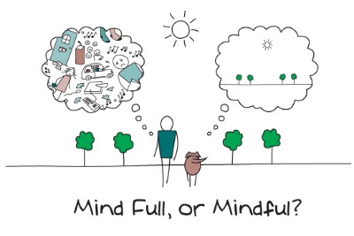
Experiential Exercise
Finding Your Still, Quiet Place (Amy Salzman, 2008)
Notes:
Mindful Movement – seaweed meditation & Amy Salzman’s Still Quiet Pleace Mindfulness Meditation
I would like to share one of my favorite places with you. I call it the Still Quiet Place. It’s not a place you travel in a car, train, or plane. It’s a place inside you that you can find by just closing your eyes.
Close your eyes and take some slow, deep breaths, See if you can feel a kind of warm, happy, smile in your body. Do you feel it? That is your Still Quiet Place. Take some more deep, slow breaths and really snuggle in.
The best thing about your Still Quiet Place is that it’s always inside you. And you can visit it whenever you like. It is nice to visit your Still Quiet Place and feel the love that is there. It is especially helpful to visit your Still Quiet Place if you are feeling angry, or sad, or afraid. The Still Quiet Place is a good place to talk with these feelings and make friends with them. When you are in your Still Quiet Place and talk to your feelings, you may find that your feelings are not as big and powerful as they seem. Remember that you can come here whenever you like, and stay for as long as you want.

Slide 65
The Still Quiet Place (Saltzman & Goldin, 2008)
Hello, my name is Amy, and I would like to share one of my favorite places with you. I call it the Still Quiet Place. It’s not a place you travel in a car, train, or plane. It’s a place inside you that you can find by just closing your eyes.
Close your eyes and take some slow, deep breaths, See if you can feel a kind of warm, happy, smile in your body. Do you feel it? That is your Still Quiet Place. Take some more deep, slow breaths and really snuggle in.
The best thing about your Still Quiet Place is that it’s always inside you. And you can visit it whenever you like. It is nice to visit your Still Quiet Place and feel the love that is there. It is especially helpful to visit your Still Quiet Place if you are feeling angry, or sad, or afraid. The Still Quiet Place is a good place to talk with these feelings and make friends with them. When you are in your Still Quiet Place and talk to your feelings, you may find that your feelings are not as big and powerful as they seem. Remember that you can come here whenever you like, and stay for as long as you want.
Notes:
One minute per age in years for practice; kids as young as 5 can remember to use this space when upset.

Slide 66

Mindfulness Practice for Teens & Adults

Slide 67
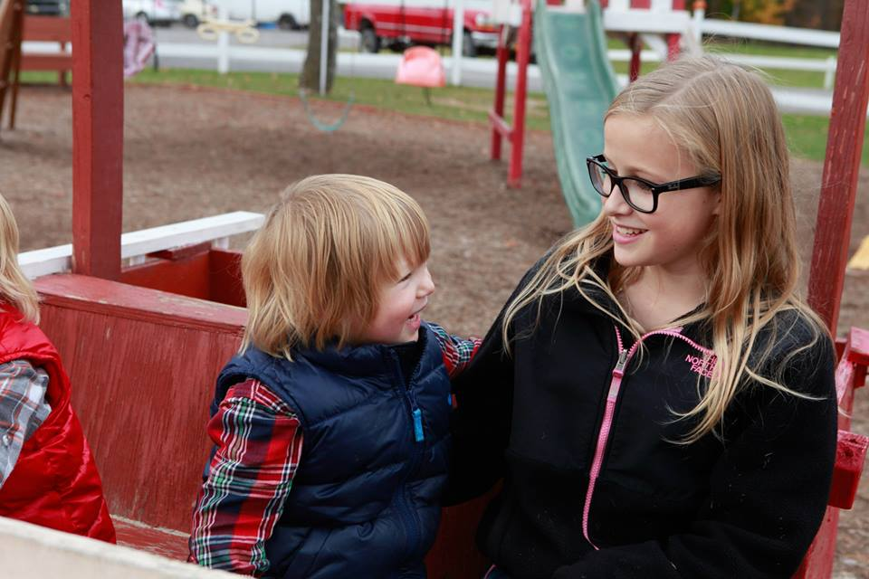
The most precious gift
we can offer others
is our presence.
When mindfulness
embraces those we love,
they will bloom
like flowers.
-Thich Nhat Han

Slide 68

Mindfulness for 2 Practice

Slide 69
What happens from an RFT perspective
I move
I touch
I am a fighter
I am broken
I make
crappy grades
I hear
I have no friends
I taste
I make mom mad
I make dad worried

Slide 70
Self as Context

Slide 71
Self-as-Context
Sense of self that is a safe and consistent
Emotions and thoughts are not the sum total of you;
You are not your experiences
You are the context in which your thoughts and feelings happen
Observe all changing experiences
  Without evaluation
  Without struggling with thoughts and feelings

Slide 72
Defusion
Defusion
Self as Context
I am having the thought that I am worthless
Fusion
Self as Content
I am a worthless person
Self as Process
I feel so worthless right now
AND
I am having the feeling that I am worthless
right now
Self as Context

Slide 73
Usefulness, and A Few Examples
Cognitive fusion: Hyperactive child who has the urge, “Get out of your seat” does so
…or experiences the urge as “very annoying” and struggles with it
If I am “a bully” I may act in ways consistent with that
  What behaviors support that self-concept?
If I am “unlovable” I may act in ways consistent with that
  When do you act in ways that contradict that?

Slide 74
For Emotion Adventurers: You Are Here
My First Name:________
I am (Four words to describe you):____________________
I am the (son/daugher of; brother/sister of, etc):________________________
I love:_____________________________________
I am excited by:_________________________________________
I need:_____________________________________________________
I give (to others):______________________________________________
I fear:________________________________________________
I wish I could:_______________________________________________
I live at:__________________________________________
My Last Name:________
Notes:
Kids are in the unique position of having fine, critical minds, and yet being limited in the ability to understand and appreciate how they work given their less sophisticated abstract thinking and verbal skills. This varies across childhood, of course. But the mind’s relational abililty begins very young.

Slide 75
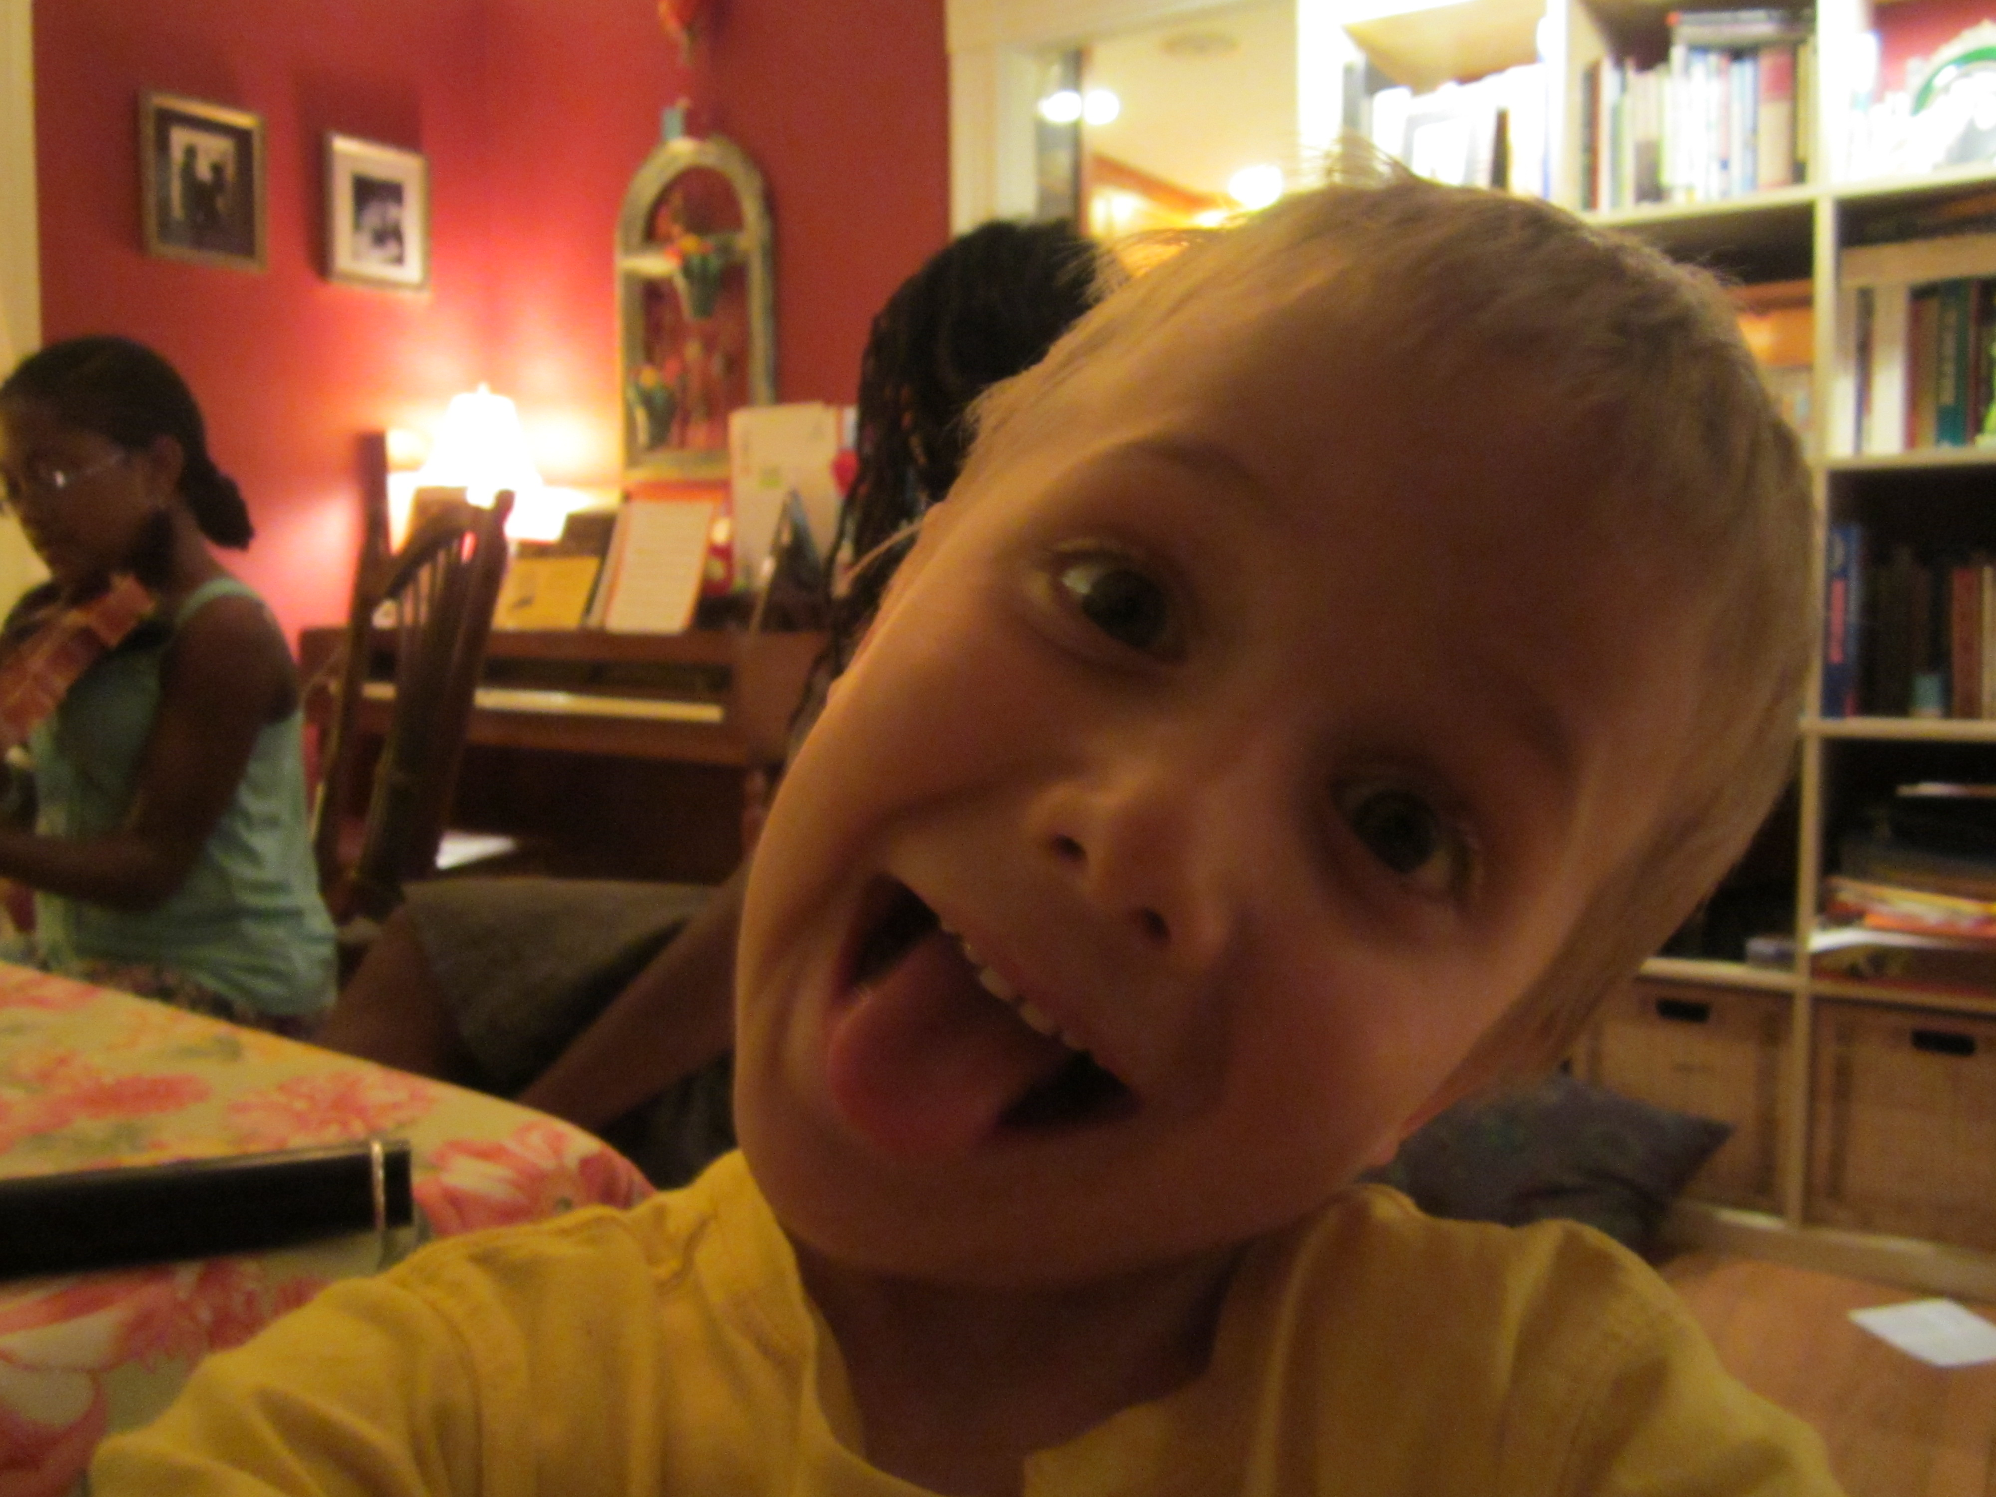
All the Words for Me
Things I Do
Things I Think
Things I Feel

Slide 76

Watching the Storm from your Still Quiet Ship
Notes:
Experiential Exercise: When you are angry, close your eyes, and imagine you are in a huge sailing ship that is heavy and safe in the water. Outside the porthole of your ship is the sky, and it is stormy. Your feelings and thoughts are the stormclouds – you can watch them safely from inside your ship. You are out on a wide ocean, and the sky touches the sea all around you. You are close to stormclouds, but you safe in your steady ship. Watch what they do outside the porthole. What do they look like? Are they moving slowly or quickly? Is there lightning? Thunder? Rain? Let me know how they move, and when they come and go.

Slide 77
Watching the Storm from your Ship
When you are angry, close your eyes, and imagine you are in a treehouse. Outside the window of your treehouse is the sky, and it is stormy. Your feelings and thoughts are the stormclouds – you can watch them safely from inside your treehouse. You are high up in the tree, so you are close to them, but you far enough away to be safe in the treehouse. Watch what they do outside the window. What do they look like? Are they moving slowly or quickly? Is there lightning? Thunder? Rain? Let me know how they move, and when they come and go.
Notes:
EDIT

Slide 78
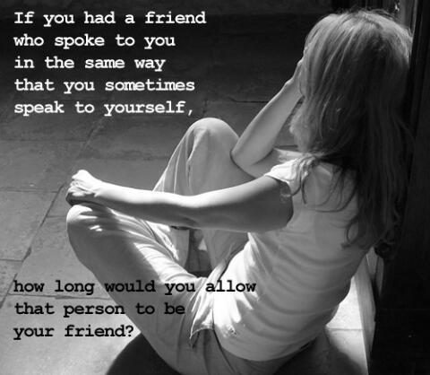

Slide 79
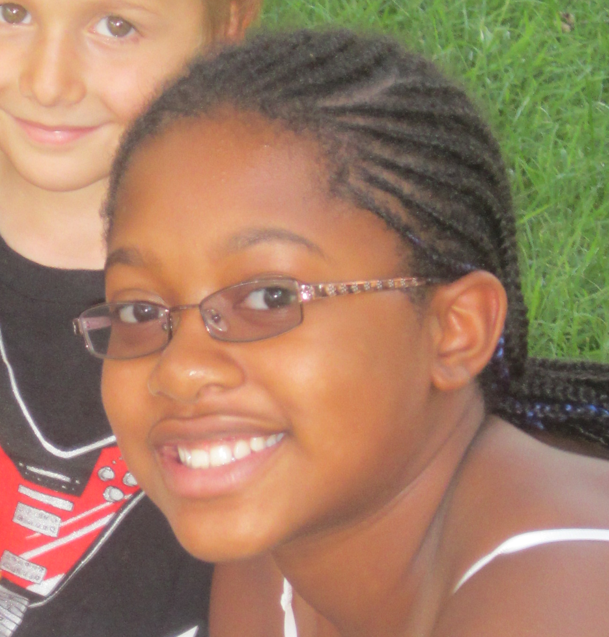
The Ways of Being Worksheet
At School
With my Friends
At Home

Slide 80
What happens from an RFT perspective
I move
I touch
I am a fighter
I am broken
I make
crappy grades
I hear
I have no friends
I taste
I make mom mad
I make dad worried
I ≠ my ways of being. I am more than them. I can choose among them.

Slide 81
I have my thoughts and feelings…
…they don’t have me!

Slide 82
From an RFT Perspective…
Necessary frames
  I/you
  Now/then
  Here/there
Builds to
  Me/my experiences
  Me/my behaviors (ways of being)
  In context
Rule-governed: pliance or tracking?

